Slide 1
jsFinance CLI App
Joseph Mathew and Sarah Witzig
CS5200 Fall 2023

Slide 2
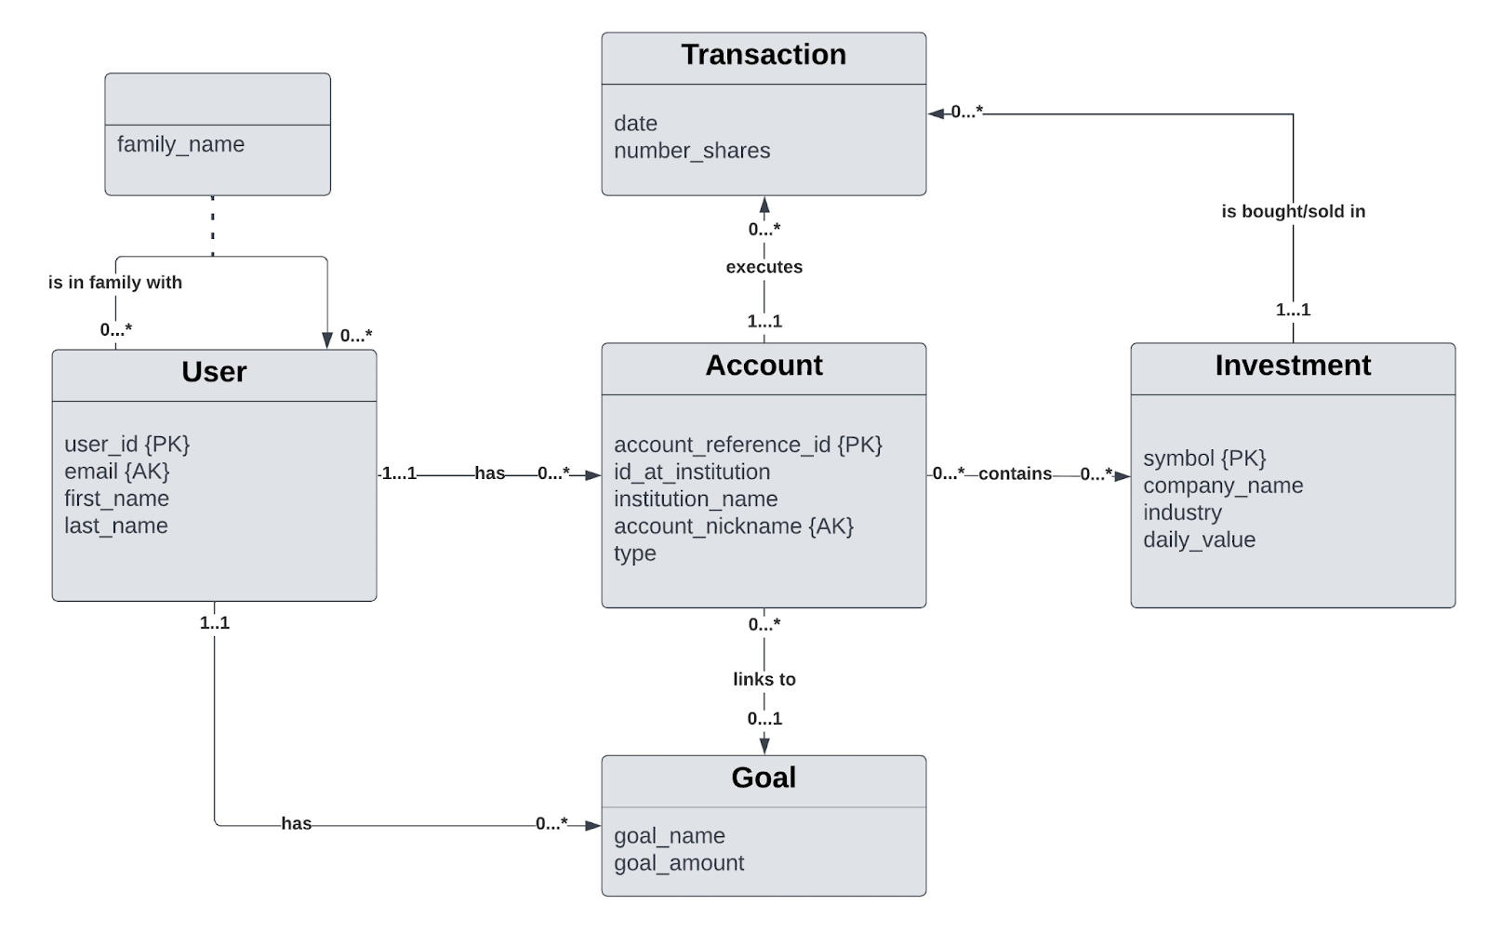
Overview and Data Schema
jsFinance is a portfolio management application
Underlying data schema

Slide 3
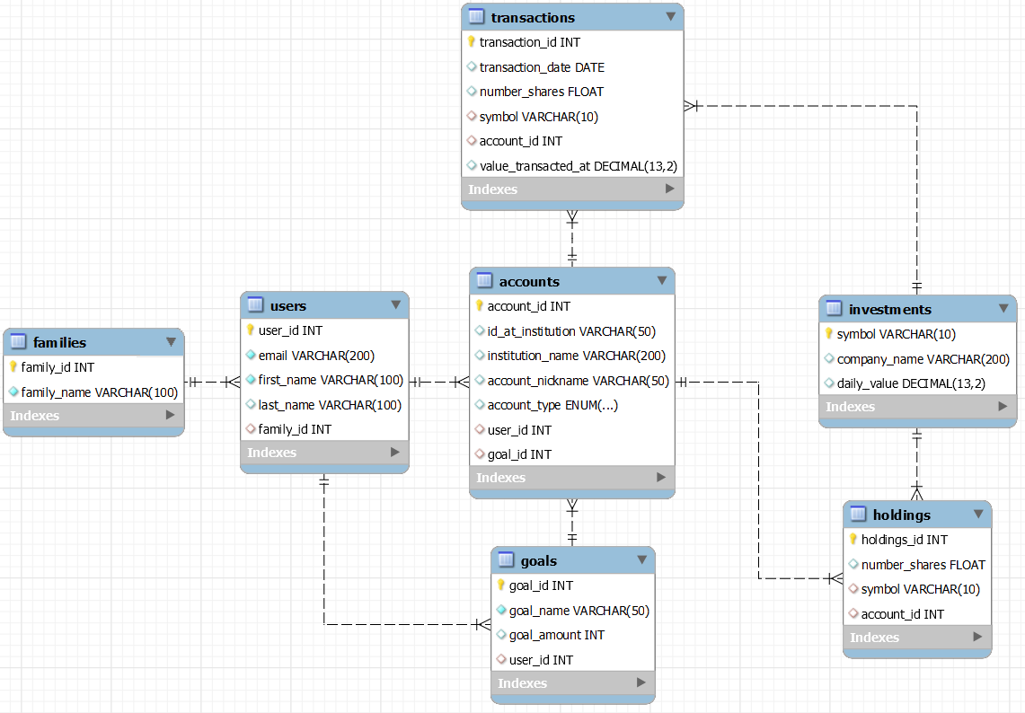
Logical Database Design

Slide 4
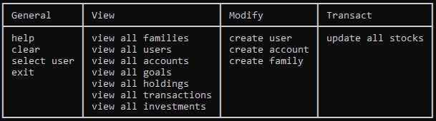
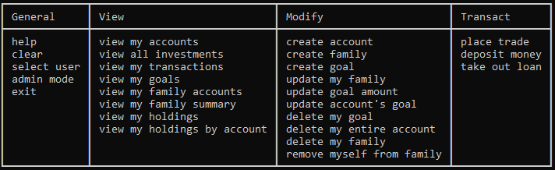
Application Description
Program screenshot: Admin commands menu
General functionality:
Two distinct roles: user (logged in), and Admin
Some commands are exclusive, some are shared between roles
Admins can get a view of the entire database
User views focus on goals, accounts, and transactions
User can: Buy stock, sell stock, take out a loan, deposit money
Program screenshot: User commands menu

Slide 5
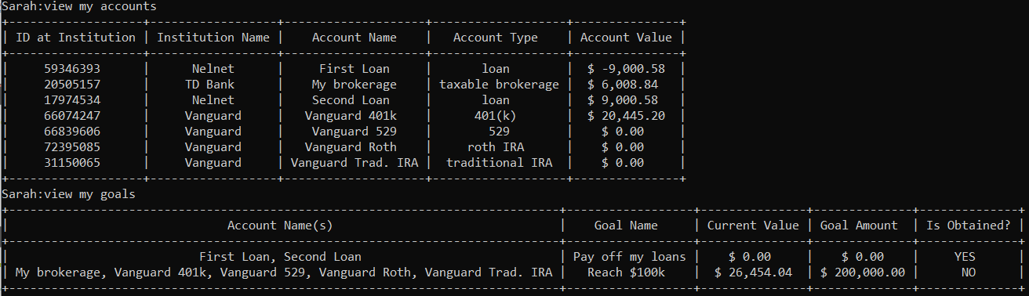
Demonstration
Run run_jsfinance.py

